Slide 1

DATA 515A
Software Design for Data Scientists Data Visualization in DASH
Joseph Hellerstein^{1,3}, Bernease Herman^{1,} Sam Gao³
¹eScience Institute
³Computer Science
University of Washington
April, 2019

Slide 2
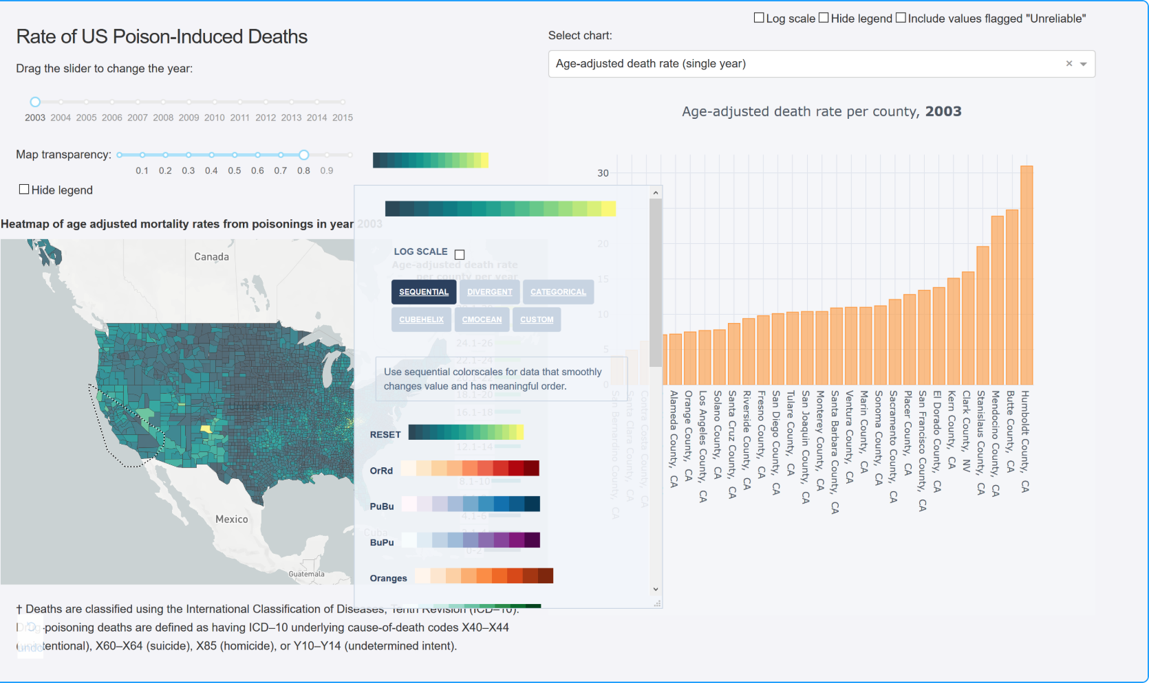
Cool Visualization Using Python Dash

Slide 3
Agenda
HTML and CSS basics
Dash architecture and example
Adding visual elements
Interactions
Maps
Testing

Slide 4
Elements of Browser Programmer
HTML (hypertext markup language)
Tag language like markdown that controls visual display
CSS (cascading style sheets)
Controls fonts, colors, table styles
JavaScript
Program reaction to browser events

Slide 5
A Brief Tour of HTML
Demo

Slide 6
Python Dash Application Architecture
import dash
...
app = dash.Dash(__name__)
app.layout=[…]
...
if __name__ == '__main__’:
app.run_server()
Python Application
Web Browser

Slide 7
References
w3Schools HTML Tutorial
w3Schools CSS Tutorial
w3Schools JavaScript Tutorial
Dash Users Guide

